Slide 1

Swiggy Analysis

Slide 2
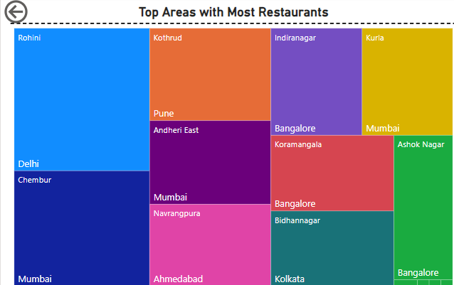
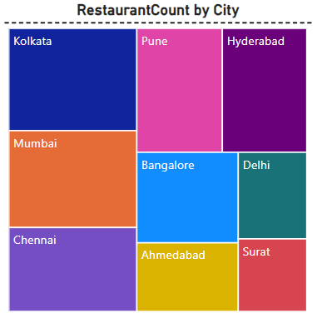
Top 10 Areas with Most Restaurants & Restaurant count by City
Tree Chart effectively displays the hierarchical relationship.
Data types used Area, City & Restaurant count.
Top Area Rohini, Delhi with a 257 count.
Last Ashok Nagar, Bangalore with a count of 113.
Kolkata has highest restaurant of 1346 & Surat has 512.

Slide 3
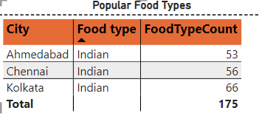
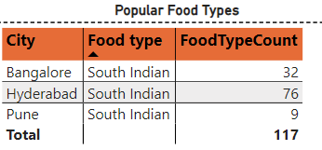



Top Food Types in Each City
The tabular format is straightforward and easy to interpret.
Created a Measure “Food Type Count”
The table can highlight market trends

Slide 4
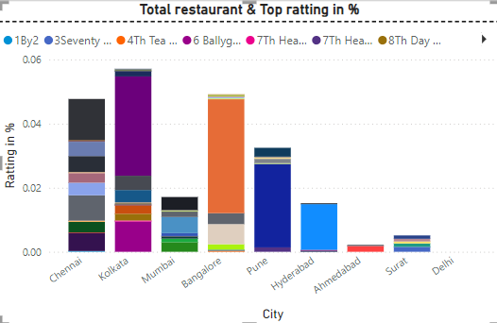
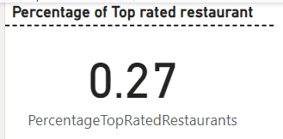
Top Rated Swiggy Restaurants (In %) Above 4.5
Stacked Column Chart effectively shows the proportion of top-rated restaurants relative to all restaurants.
Identifying this helping to focus on successful regions and address areas needing improvement.

Slide 5
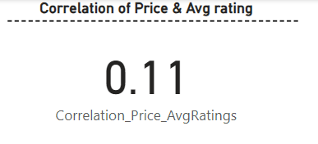
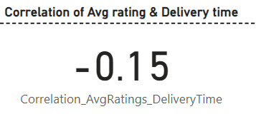
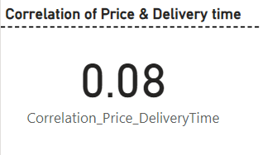
Correlation of Factors Affecting Average Rating
Comparing these Price and delivery time has a notable impact on ratting.
Correlation between Rating and Delivery Time indicates that the longer delivery times tend to result in lower customer ratings.

Slide 6
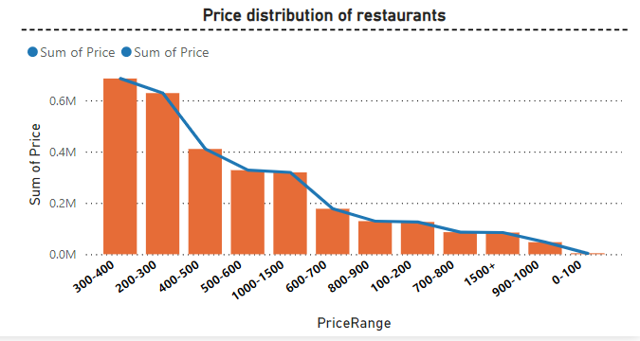
Price Analysis
Based on this mid-range prices dominates the market.
0-100 – This range has very low demand, as people less likely purchase this price range items.
And the status top price rand indicates that there will be a significant opportunity available in premium market.

Slide 7
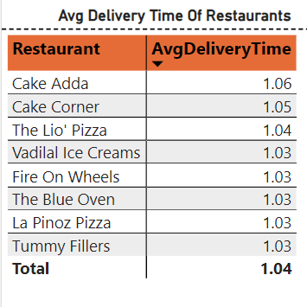
Delivery Time Analysis
As we saw before delivery time has a significant effect on the customer satisfaction.
Identifying restaurants with consistently long delivery times can help target operational improvements and streamline delivery processes.

Slide 8
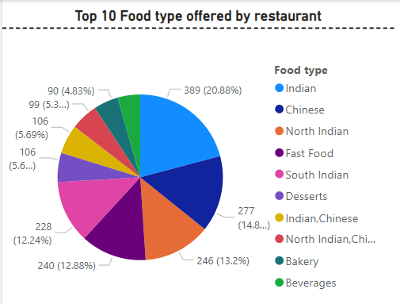
The types of cuisines offered by Restaurants
I Used Pic chart to show the distribution of the food type.
Indian cuisine is the most popular, representing 20.88% of the offerings

Slide 9
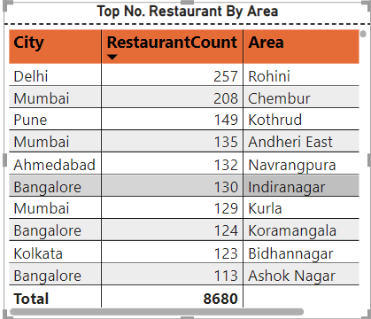
Correlation of Factors Affecting Average Rating
Used Table visual to present the data. And slicer to filter the data.
Identify densely populated areas with high restaurant counts.
These areas are potential hotspots for Swiggy delivery services.

Slide 10
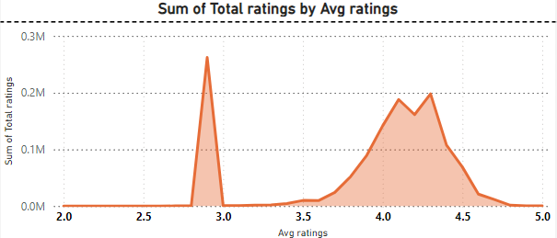
Correlation of Factors Affecting Average Rating
Many customers seem to rate consistently around the lower average rating (just above 3).
The broader peak at higher average ratings (around 4.0) indicates positive sentiment.
Investigate factors influencing the lower average ratings.

Slide 11
Business Recommendations
Target marketing campaigns based on customer preferences and behavior.
Feature top-rated restaurants prominently to boost visibility and orders.
Optimize delivery times in high-demand areas to improve customer satisfaction.
Implement loyalty programs to retain high-value customers.
Entering higher-priced categories (above $900) and partnering with premium restaurants to attract the premium market segment.

